Slide 1
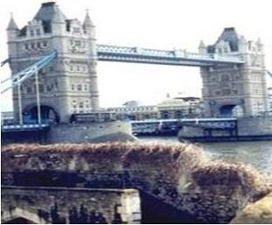
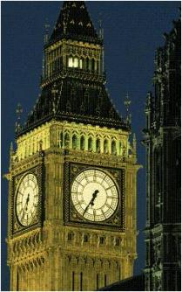
Culture and traditions of England
Elena Bodashkova
Gymnasium 56
Class 10a

Slide 2
English culture
Language: English Prominent British: Daniel Defoe, Charles Dickens, Rudyard Kipling, Jonathan Swift, Alan Milne, Agatha Christie, Oscar Wilde, Walter Scott, Byron, Shakespeare, Smith, Maxwell, Rayleigh, Thomson. Religion: Hinduism, Islam, Judaism and Sikh Greatest contribution to the field: literature, theater, architecture

Slide 3
Mentality
People in England are quiet, restrained, reasonable, hardworking, polite . They observe traditions.

Slide 4
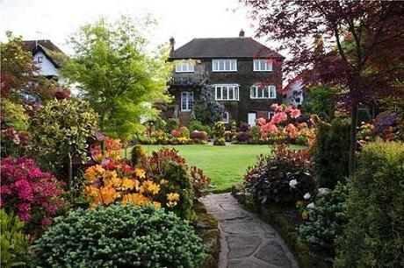
Hobbies and Leisure
1)Football, fishing, cricket gambling
2) Spend vacations and holidays with family
3) Gardening
4) Pets

Slide 5
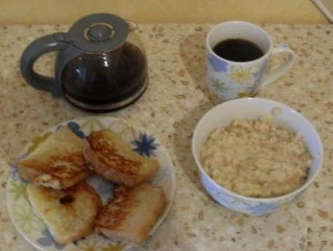
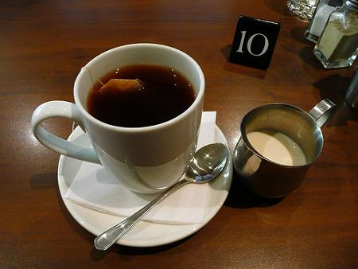
Meal profiles
English breakfast: oatmeal, yaishnitsa (eggs), coffee, toast, juice
Afternoon tea: sandwiches, scones with jam and icing; it is at 15 – 17 (18) o clock. It is a time to talk with relatives.

Slide 6
Family in England
Family is important for British. By tradition, the British met Christmas with family. But they had little time to spend with family.
Sometimes they do not like holidays, christenings, weddings, because they require a lot of training and deliver a lot of problems.
Knowing family tree of business partner can help you in business.
But the British are very proud of their family tradition.
Good manners do not allow them to be interested in the personal affairs of a partner. Of course, their own life going on behind a veil of secrecy If someone invited you to his home he very respect you.

Slide 7
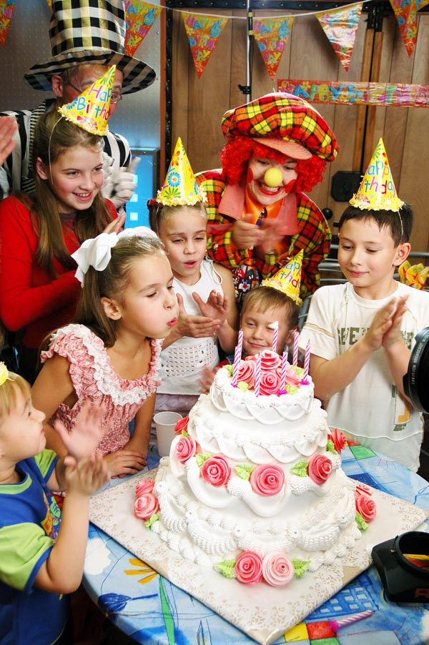
Holidays
For example:
January – New Year Christmas
April – exploration of flowers
May - Spring Festival
June – King National Festival
And: Chimney Sweep Festival, Art Festival ,summer festival ,Robin Hood Festival.

Slide 8
Education in family
English education can seem very harsh and smart. English think that it is better and will benefit for children. Typical English proverb sounds like: "spare the rod - spoil the child". British traditionally belong to the children is very restrained, forming a child's habit to restrain his feelings.
Since a good upbringing and education is one of the traditional British values, the British send their children to school away from the parental home (such as eminent schools and hostels), believing that this way, children will quickly learn independence and responsibility. Strict discipline and very strict orders pensions, according to parents, contribute to the education of this Englishman.

Slide 9
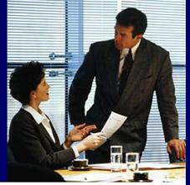
Working
The British prefer to make decisions in a team. The British work harder than they are very proud of, but inferior in that the Germans and Italians. Subordinate like, when orders were given to the form of requests rather than orders.

Slide 10
Literature:
http://www.langust.ru/lang-c.shtml
http://www.englishgroup.ru/index.php?look=1229003121
http://bizataka.ru/biznes-naprvleniya/ved/mentalitet-natsii-i-delovoe-sotrudnichestvo-angliyskaya-model-obscheniya.html

